Slide 1

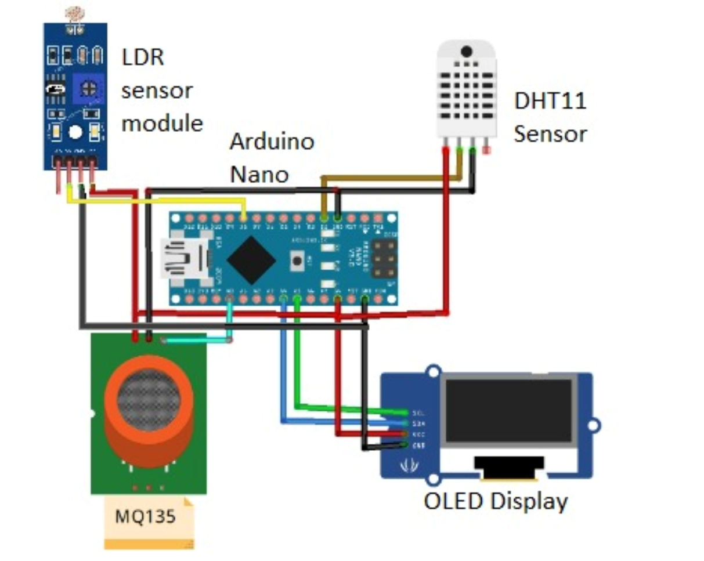
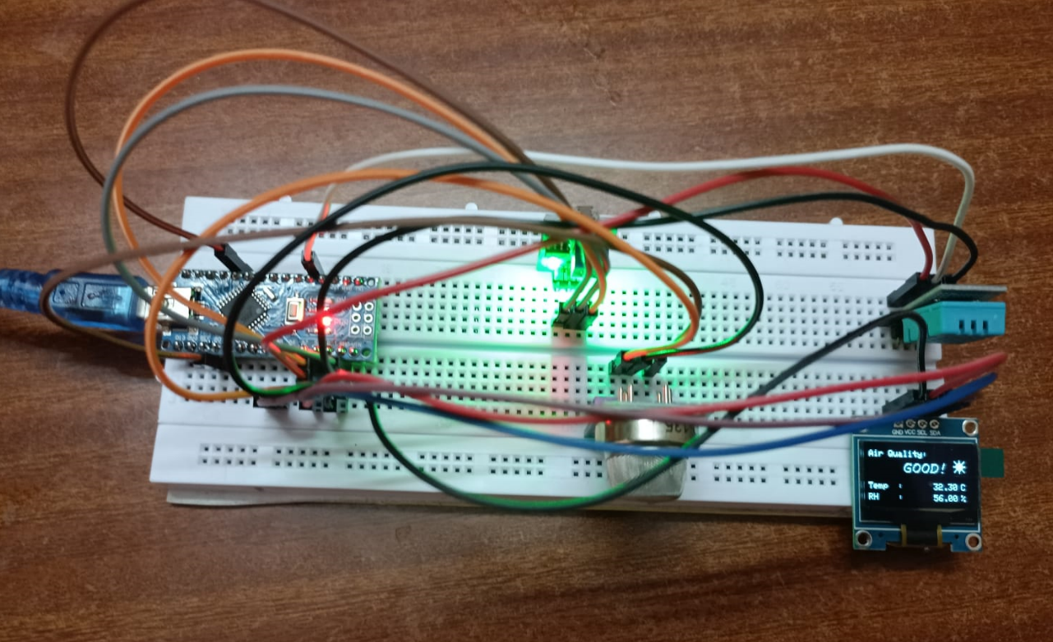




UE22CS251B: MPCA Combined Air Quality, Temperature, and Humidity Sensor
We developed an Arduino-based circuit with DHT11,LDR sensor module and MQ135 sensors, displaying air quality, temperature, Light and humidity on an OLED display. Our user-friendly solution offers swift environment safety assessment, promoting accessibility and informed decision-making for societal well-being
PIC of the actual Model developed
Rhushya
PES2UG22CS440
Rithvik Muthyalapati
PES2UG22CS451
Rohan S
PES2UG22CS456
Dr. Charu Kathuria

